Slide 1
Defuzzification Methods
Prof. Sonal Shroff
Computer Engg Dept
TSEC

Slide 2
Introduction
Reverse process of fuzzification
Conversion of a fuzzy set to single crisp value
Mathematically, the defuzzyfication process is termed as rounding it off
There are various method suggested. The selection of method to be used depends on
Applicability to the situations considered
Plausibility of the outputs obtained based on engineering point of view
Experience of the designer

Slide 3

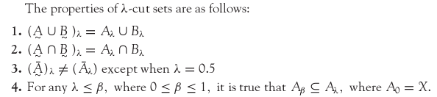
λ-cut for Fuzzy sets(α-cut)

Slide 4


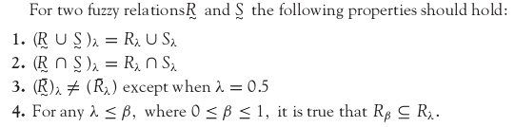
λ-cut for Fuzzy Relations

Slide 5
Defuzzification Methods
Defuzzification is the process of conversion of a fuzzy quantity into a precise quantity. Defuzzification methods include:
Max-membership principle,
Centroid method,
Weighted average method,
Mean-max membership,
Center of sums,
Center of largest area,
First of maxima, last of maxima.

Slide 6
Max-membership principle
This method is also known as height method and is limited to peak output function. This method is given by the algebraic expression
μ_{c}(z*) ≥ μ_{c}(z) ∀ z ∈ Z
Max-membership defuzzification method
μ
1
z* z

Slide 7
Centroid Method
This method is also known as center of mass, center of area or center of gravity method. It is most commonly used defuzzification method. This method is given by the algebraic expression
The symbol denotes an algebraic integration
Centroid defuzzification method
μ
1
z* z

Slide 8
Weighted average Method
This method is valid for symmetrical output membership functions only. Each membership function is weighted by its maximum membership value. The output here is given by
Weighted average defuzzification method
-produces results very close to centroid method
μ
.9
.5
0 a b z

Slide 9
Mean-Max membership
This method is also known as middle of maxima. This is closely related to max-membership method, except that the locations of the maximum membership can be nonunique. The output here is given by
Mean-max membership defuzzification method
μ
1
0 a z* b z

Slide 10
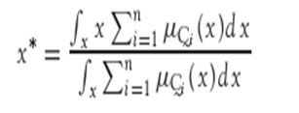
Center of Sums
This method employs the algebraic sum of the individual fuzzy subsets instead of their union. The main drawback is that intersecting areas are added twice. The output here is given by
It is similar to the weighted average method, but the weights are the areas, instead of individual membership values.

Slide 11

Center of Largest Area
This method can be adopted when the output consists of at least two convex fuzzy subsets which are not overlapping. The output here is given by
It is similar to the weighted average method, but the weights are the areas, instead of individual membership values.

Slide 12
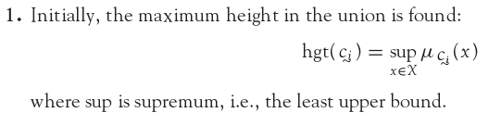
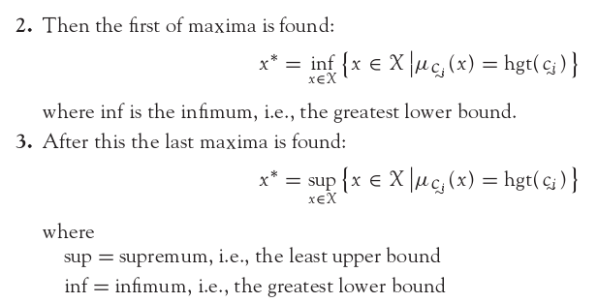
First of Maxima (Last of Maxima)

Slide 13
Centroid Method – Example
Fuzzy sets A₁, A₂ and A₃

Slide 14
Centroid Method – Example
Aggregated fuzzy set of A₁, A₂ and A₃

Slide 15
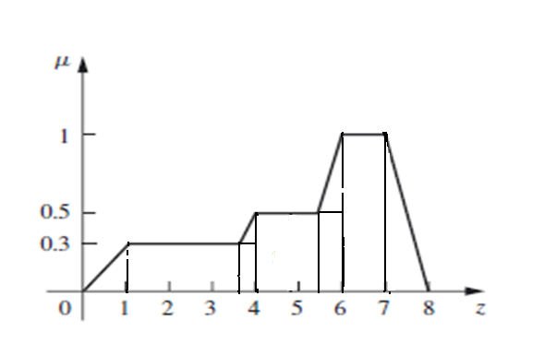
Centroid Method – Example
Aggregated fuzzy set of A₁, A₂ and A₃ viewed as area segments

Slide 16
Centroid Method – Example
Area Segment No. | Area (A)
1 | ½×0.3×1=0.15 | 0.67 | 0.1005
2 | 2.6×0.3=0.78 | 2.3 | 1.794
3 | 0.3×0.4=0.12 | 3.8 | 0.456
4 | ½×0.4×0.2=0.04 | 3.8667 | 0.1546
5 | 1.5×0.5=0.75 | 4.75 | 3.5625
6 | 0.5×0.5=0.25 | 5.75 | 1.4375
7 | ½×0.5×0.5=0.125 | 5.833 | 0.729
8 | 1×1=1 | 6.5 | 6.5
9 | ½×1×1=0.5 | 7.33 | 3.665

Slide 17
Centroid Method – Example

Slide 18
Summary
Defuzzification process is essential because some engineering applications need exact values for performing the operation.
Example: If speed of a motor has to be varied, we cannot instruct to raise it “slightly”, “high”, etc., using linguistic variables; rather, it should be specified as raise it by 200 rpm or so, i.e., a specific amount of raise should be mentioned.
The method of defuzzification should be assessed on the basis of the output in the context of data available.

